Slide 1

Pedestrian Safety in Greater Wilshire
HACK FOR LA
Henry Kaplan & Derek Plemons
Hack For LA Data Science
Updated July 29, 2021

Slide 2
The Question
Can existing datasets help us identify which parts of the Greater Wilshire neighborhood would get the most benefit from new road safety features for pedestrians and cyclists?

Slide 3
Sources of Data
City of LA - Traffic Accidents by Date
for data on pedestrian and cyclist traffic collisions
https://data.lacity.org/Public-Safety/Traffic-Accidents-by-date/2mzm-av8t
Mapillary.com API
for data on road safety features
https://www.mapillary.com/developer/api-documentation
Mapillary collects street-level imagery of roads and programmatically extracts data about the road design and features.
Mapillary has given us access to their database, and Hack For LA members have built tools for working with Mapillary data that we have built on.
Data collected by the City of LA on traffic accidents, extending back to 2010.
Includes the police “MO” code, classifying the type of accident.

Slide 4
Collisions with Pedestrians and Cyclists

Slide 5
Gathering city data
From the City database of traffic collisions going back to 2010, we pulled all incidents with the following police MO Codes: - 3003 — Veh vs Ped - 3008 — Veh vs Bike - 3016 — Bike vs Veh - 3501 — Ped Actions
Using the City’s shapefile for neighborhood council boundaries, we added neighborhood council information for each incident. Source: https://data.lacity.org/City-Infrastructure-Service-Requests/Neighborhood-Councils-Certified-/fu65-dz2f

Slide 6
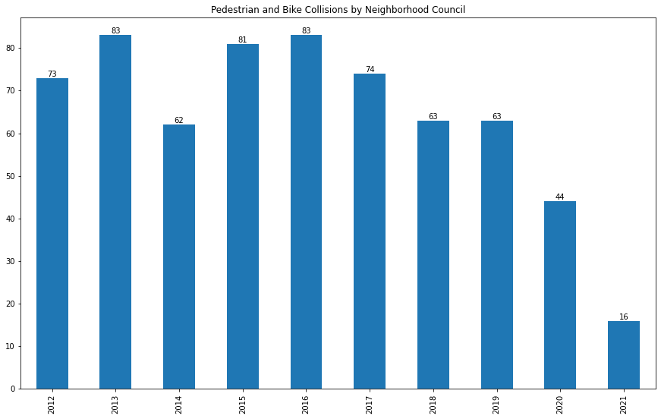
Greater Wilshire in Context
Yearly collisions with pedestrians and cyclists in Greater Wilshire

Slide 7
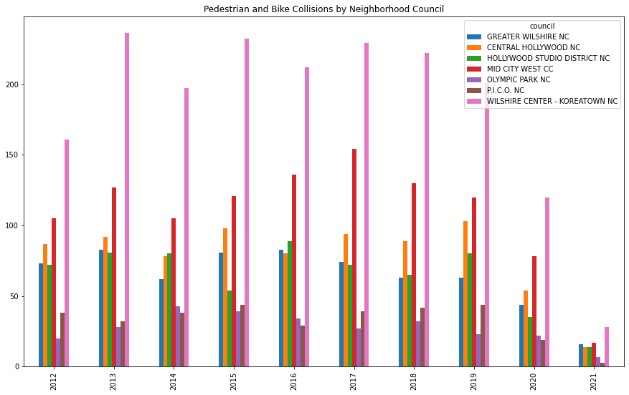
Greater Wilshire in Context
Yearly collisions with pedestrians and cyclists in Greater Wilshire
…and neighboring Neighborhood Council districts

Slide 8
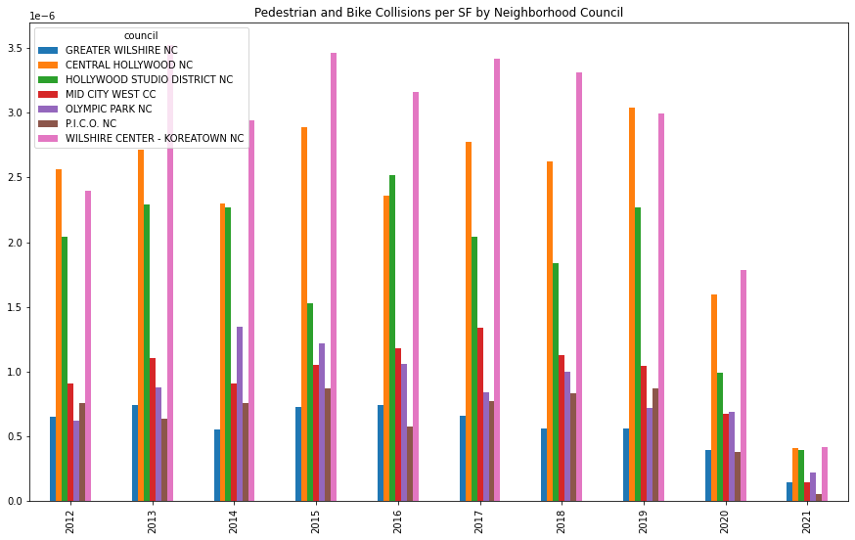
Greater Wilshire in Context
Yearly collisions with pedestrians and cyclists in Greater Wilshire
…and neighboring Neighborhood Council districts
...adjusted for council size

Slide 9
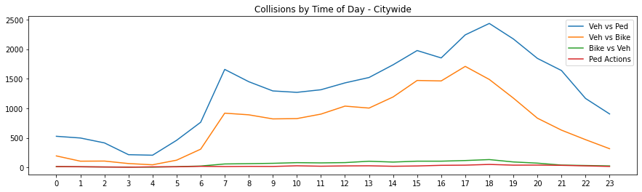
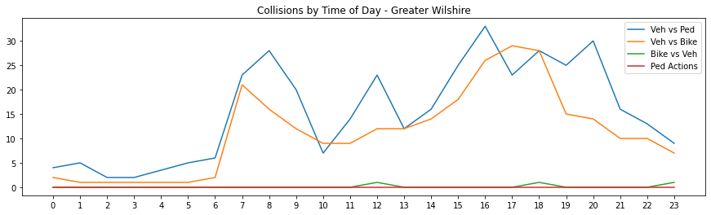
Incidents by Time of Day

Slide 10
Safety Features

Slide 11
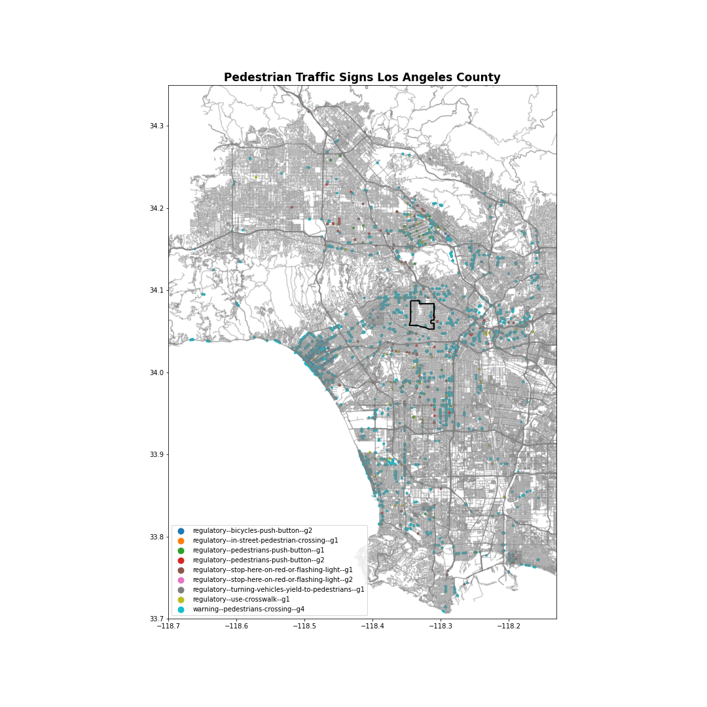
Our first attempt
We began by pulling all records from Mapillary of signs about pedestrians, crosswalks, flashing light warnings.
Mapillary signs categorized as:
4543 - warning--pedestrians-crossing--g4
119 - regulatory--bicycles-push-button--g2
108 - regulatory--stop-here-on-red-or-flashing-light--g1
105 - regulatory-use-crosswalk--g1
61 - regulatory--pedestrians-push-button--g1
49 - regulatory-pedestrians-push-button--g2
11 - regulatory--turning-vehicles-yield-to-pedestrians--g1
1 - regulatory--stop-her-on-red-or-flashing-light--g2
1 - regulatory--in-street-pedestrian-crossing--g1

Slide 12
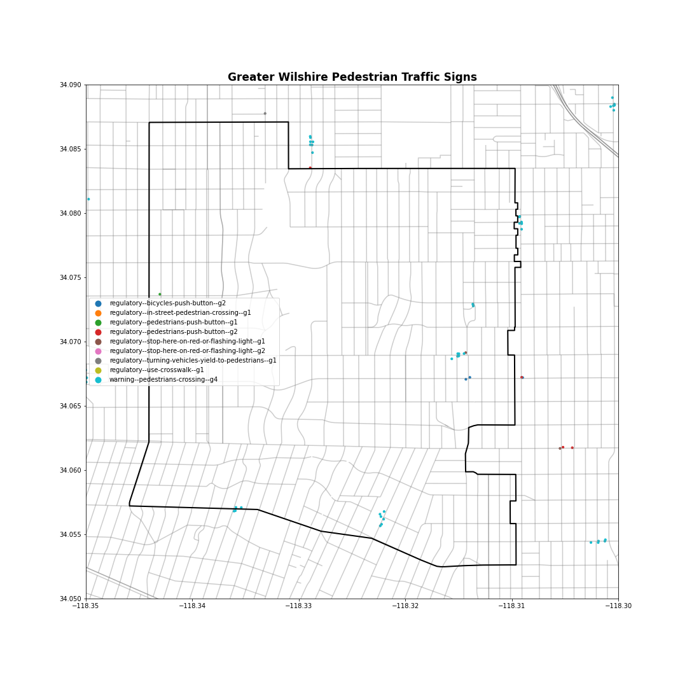
We found that Mapillary’s sign database was not a good proxy for pedestrian safety features.

Slide 13
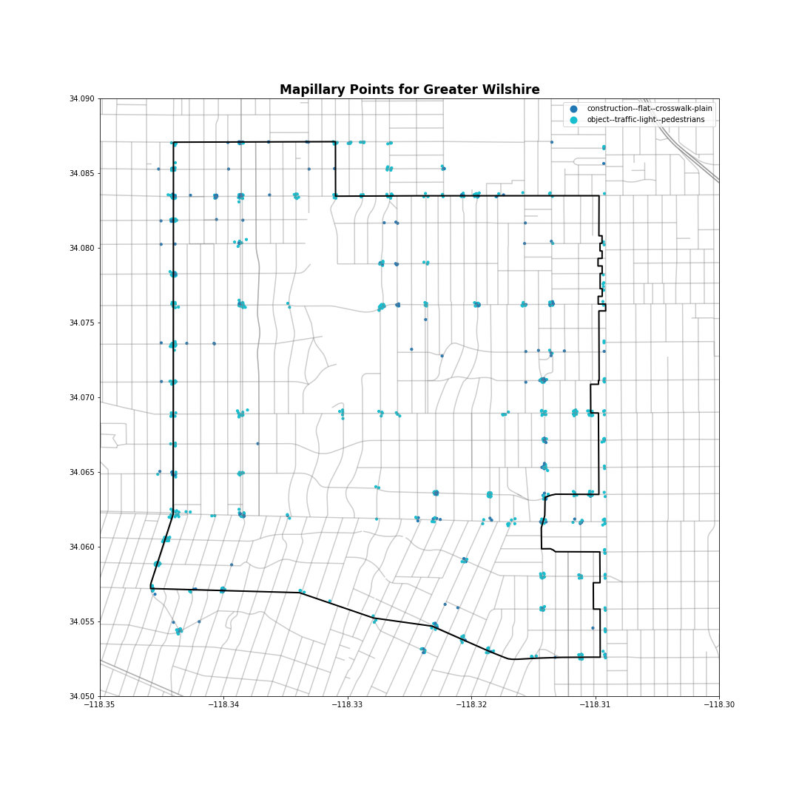
Mapping Crosswalks
Rather than mapping pedestrian warning signs, we next mapped crosswalks.
Using Mapillary’s separate “features” database, we looked at physical features catergorized as pedestrian lights or crosswalks.
Mapillary categories included:
object--traffic-light—pedestrians
marking--discrete--crosswalk-zebra
construction--flat--crosswalk-plain

Slide 14
Comparing Accident Locations to Crossing Locations

Slide 15
Overlaying Safety Features and Accidents
To look for places with more accidents and less safety features, we created a graphic with three overlays:
🟢 A green heat map of pedestrian crossing elements.
🔴 A red heat map of recorded pedestrian and cyclist collisions.
⃝ A cluster analysis of pedestrian and cyclist collisions, to sum up the total number of collisions roughly at or near each intersection.

Slide 16
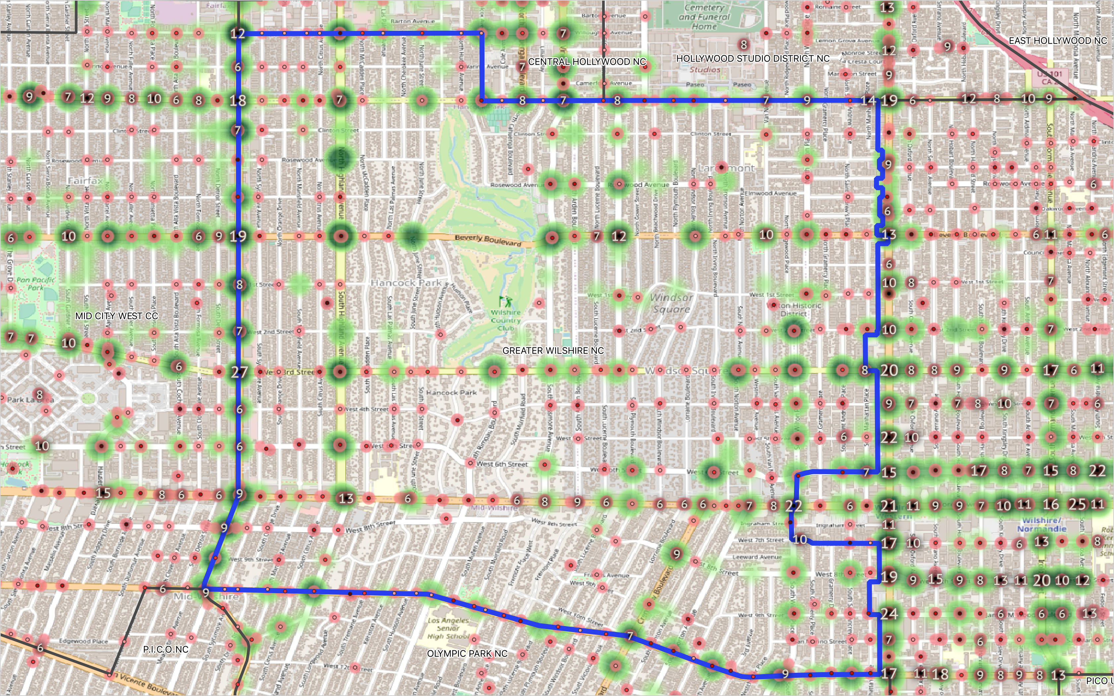

Slide 17
Clearing Unhelpful Information
To make it easier to spot patterns, we whittled away data that didn’t help us.
Charted accidents as clusters
Removed clusters with fewer than 5 accidents on record
Removed clusters outside of Greater Wilshire

Slide 18
The Final Map

Slide 19
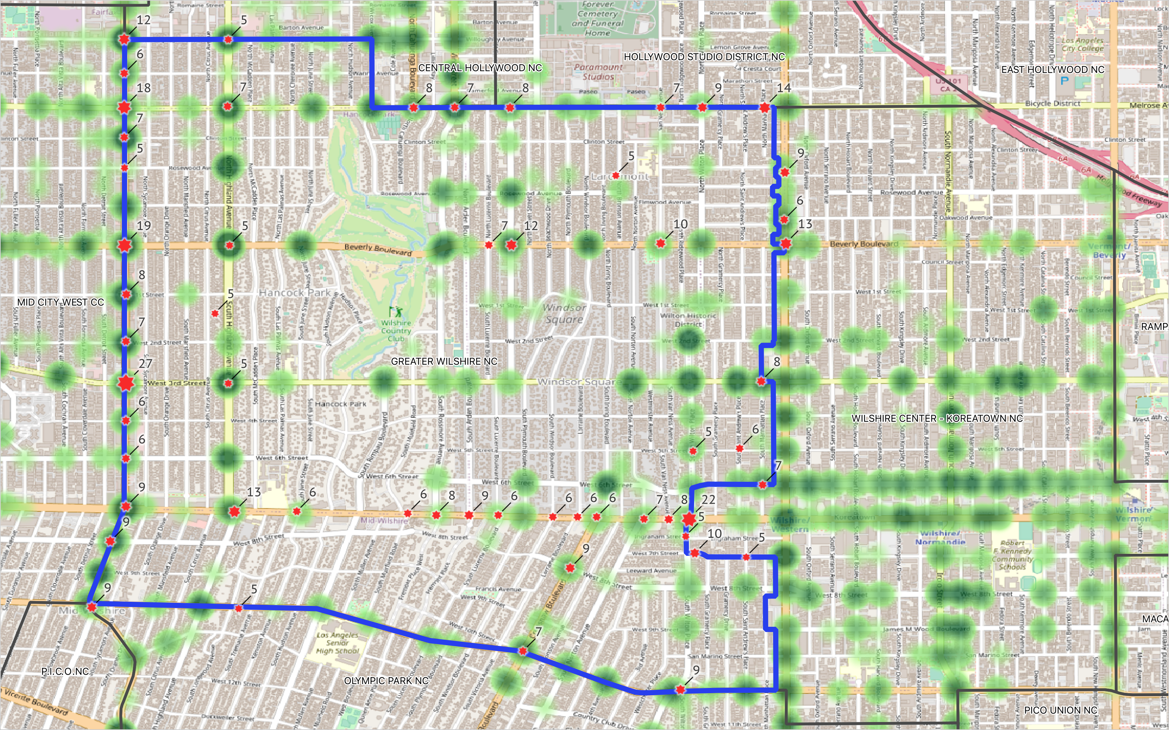
Pedestrian crossings in Mapillary’s database.
Cluster of traffic accidents involving pedestrians or cyclists in the City of LA’s database.

Slide 20
Pedestrian crossings in Mapillary’s database.
Cluster of traffic accidents involving pedestrians or cyclists in the City of LA’s database.
Standout area: Wilshire Blvd between Highland and Wilton
A pattern of accidents with pedestrians & cyclists at many intersections in a row.
Relatively unfriendly to pedestrians, with busy wide streets, and relatively sparse crosswalks.
Unlike the hotspots of accidents on La Brea, Wilshire Blvd has many intersections without crossings, and would likely benefit from more.

Slide 21
Takeaways
Looking for places with few pedestrian crossings and a history of pedestrian and cyclist collisions, the stretch of Wilshire Blvd between Highland and Wilton stands out.
We don’t see a need for more lighting — any effect nightfall has is dwarfed by other larger effects, like the rise and fall of traffic.
Overall Greater Wilshire is not one of the hotspots of pedestrian and cyclist collisions in the City.

Slide 22
Where We Can Look Deeper
Differentiating between bicycle and pedestrian accidents
Looking for other patterns in the timing of accidents
- Weekdays vs weekends
- Comparing to traffic congestion data
Researching other effects of road design on traffic safety, such as…
- Speed limits
- Width of streets
- Number of lanes
- Medians / pedestrian islands

Slide 23
Thank you!
HACK FOR LA
Henry Kaplan & Derek Plemons
Hack For LA Data Science

